Slide 1

AUGMENTED AND VIRTUAL REALITY IN HEALTH CARE
ARYA SHAHI
B.TECH 2ND YEAR
ECE DEPARTMENT
1913212

Slide 2

OUTLINE
Augmented Reality
Virtual Reality
General Applications
Application in Healthcare Industry
Major Challenges
Future Opportunities
Conclusion
References

Slide 3
AUGMENTED REALITY
Real World
Virtual Layer
Augmented Reality

Slide 4
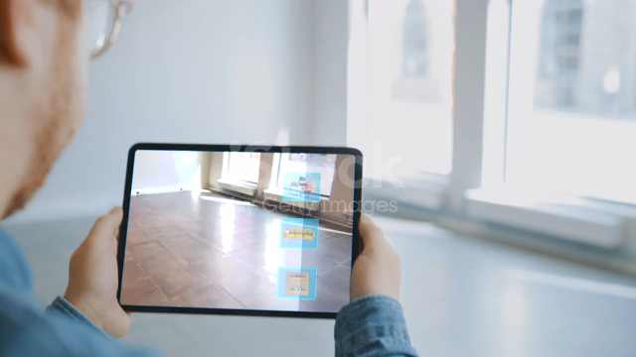
PRACTICAL DEMONSTRATION

Slide 5
VIRTUAL REALITY
Virtual World
Real Inputs
Virtual Reality

Slide 6
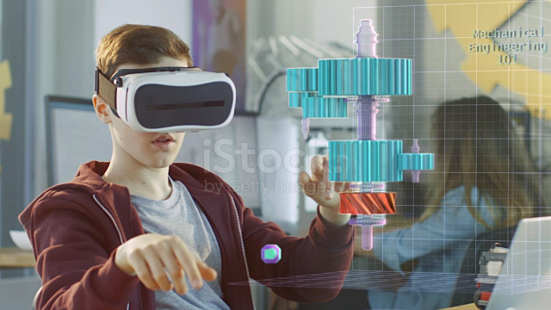
PRACTICAL DEMONSTRATION

Slide 7
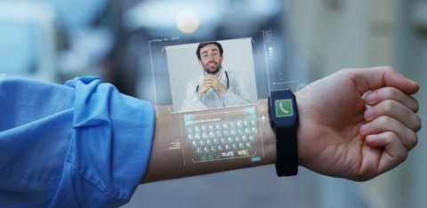
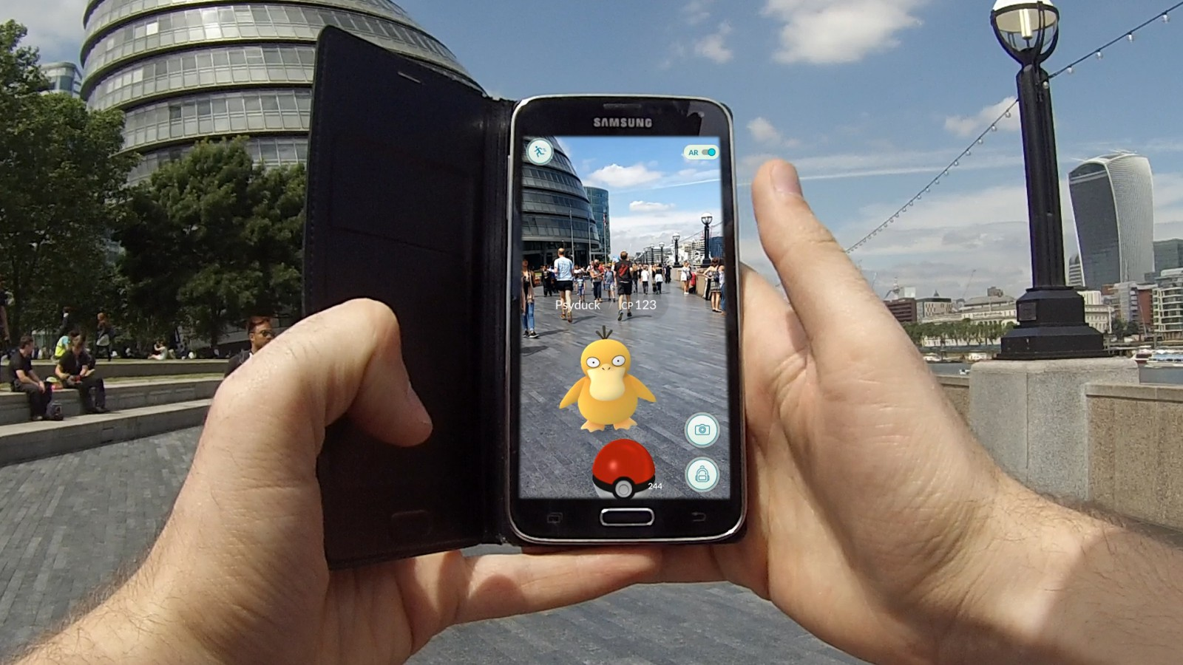
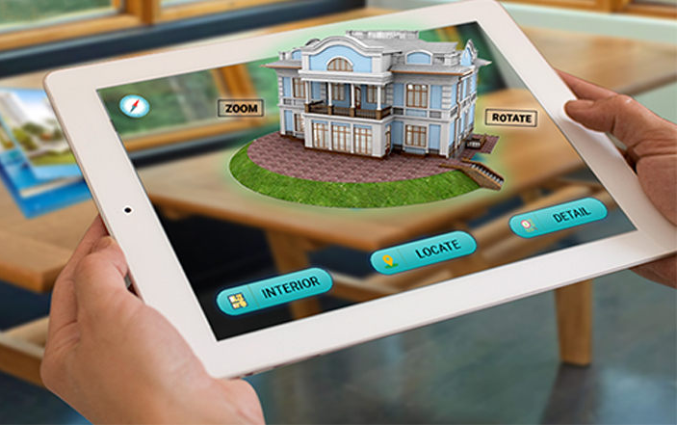
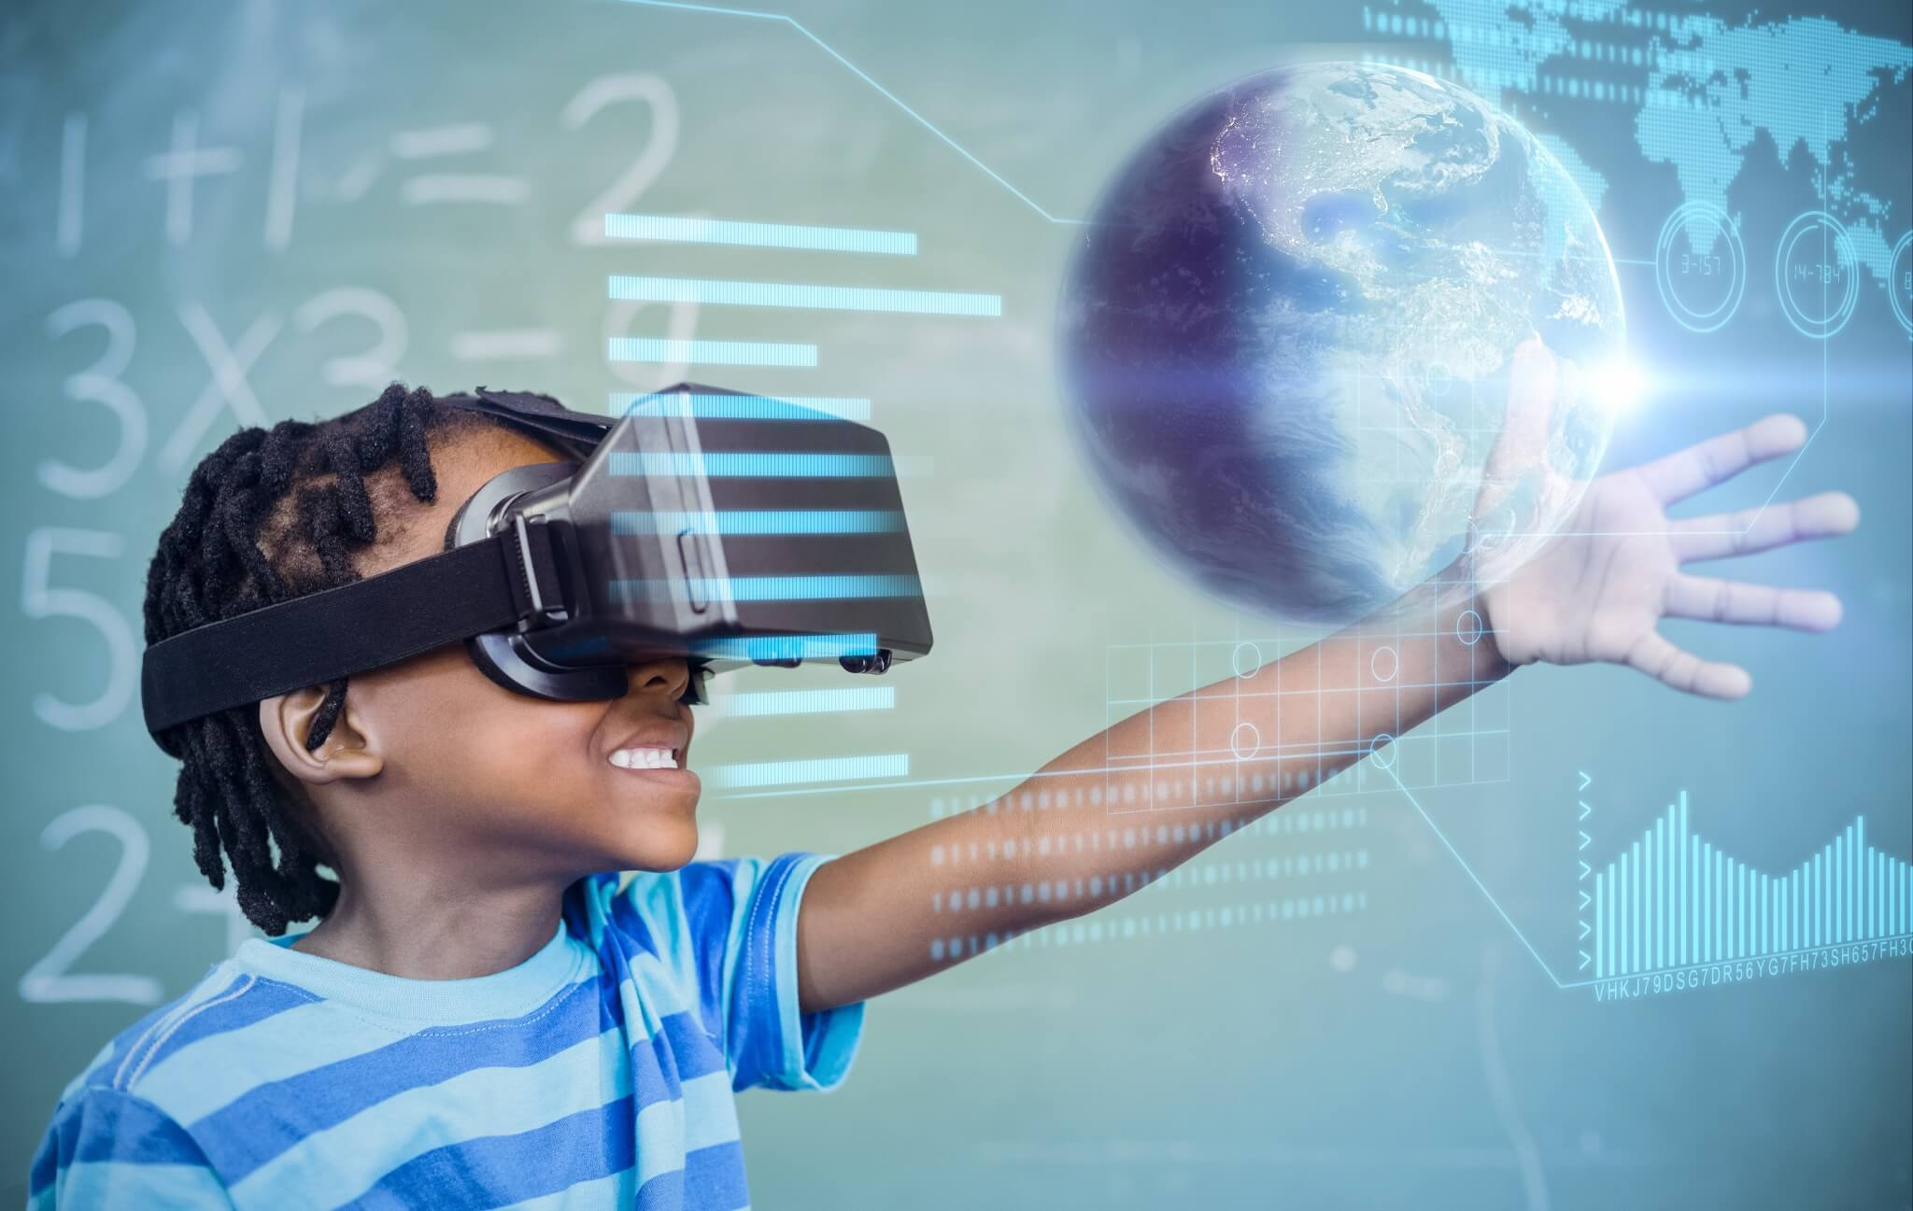
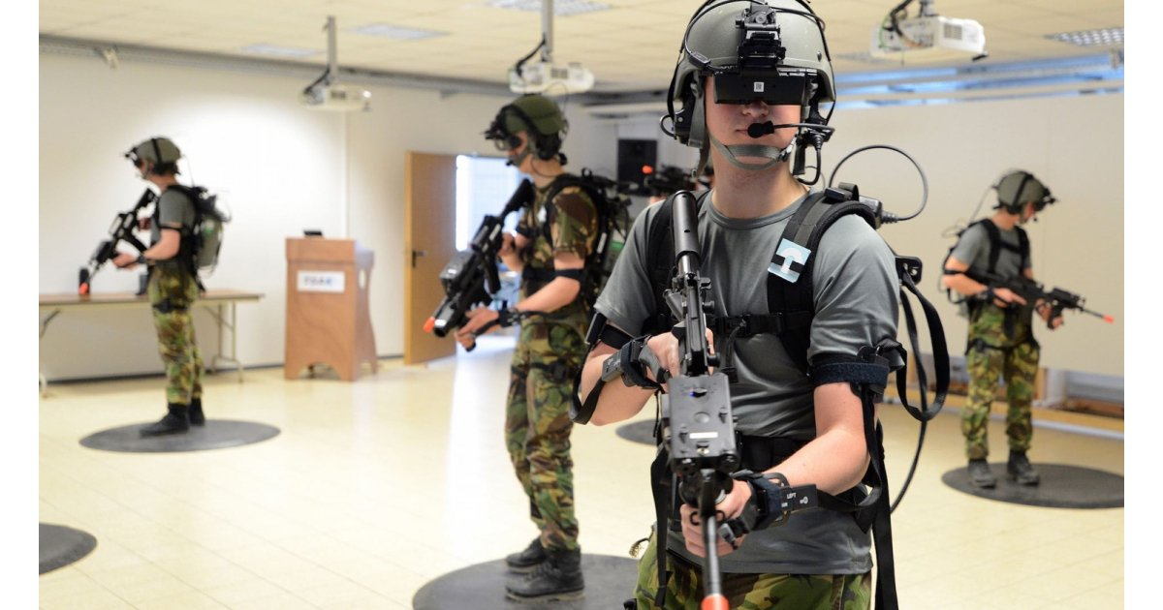
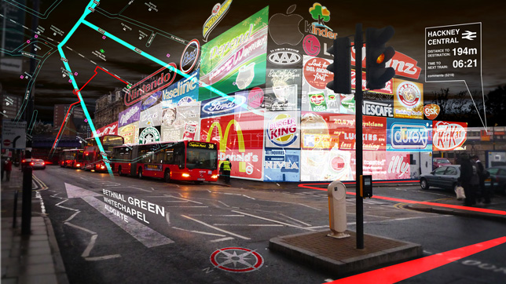
APPLICATIONS
OF
AR VR
HEALTHCARE
ENTERTAINMENT
EDUCATION
TRAVEL
MILITARY
REAL ESTATE

Slide 8

AR VR IN HEALTHCARE
HEALTH IS WEALTH!!

Slide 9
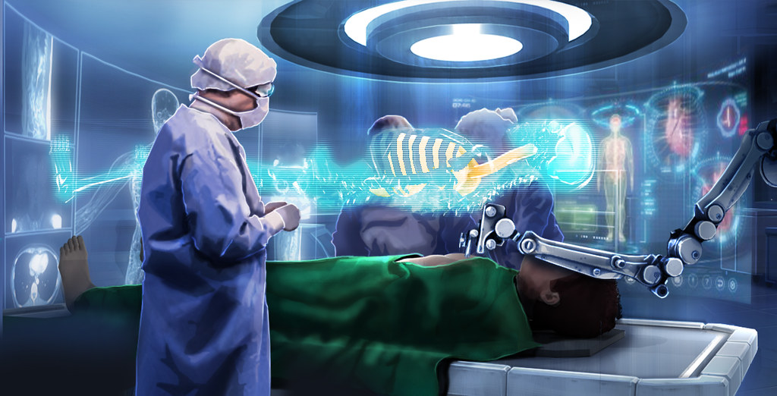
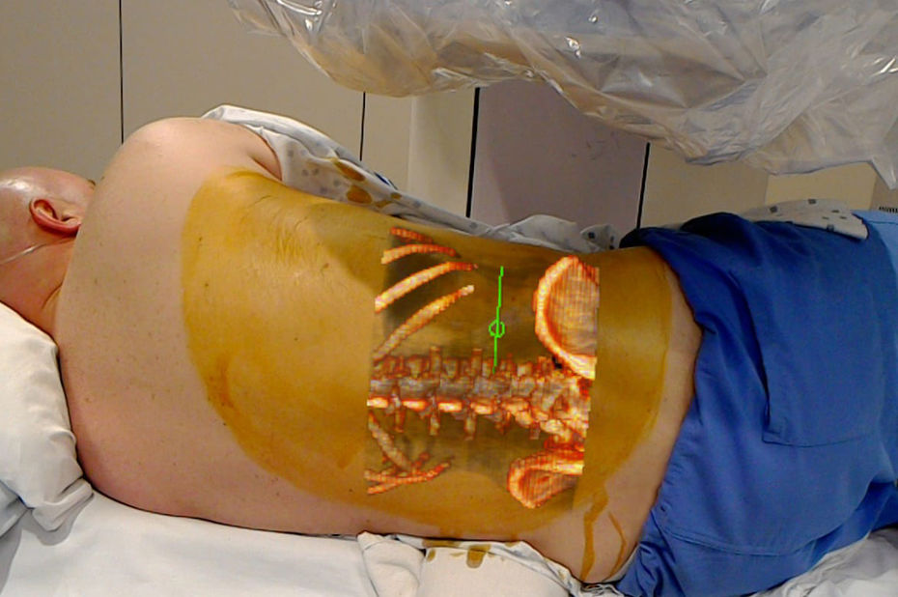

VIRTUAL SURGERIES

Slide 10
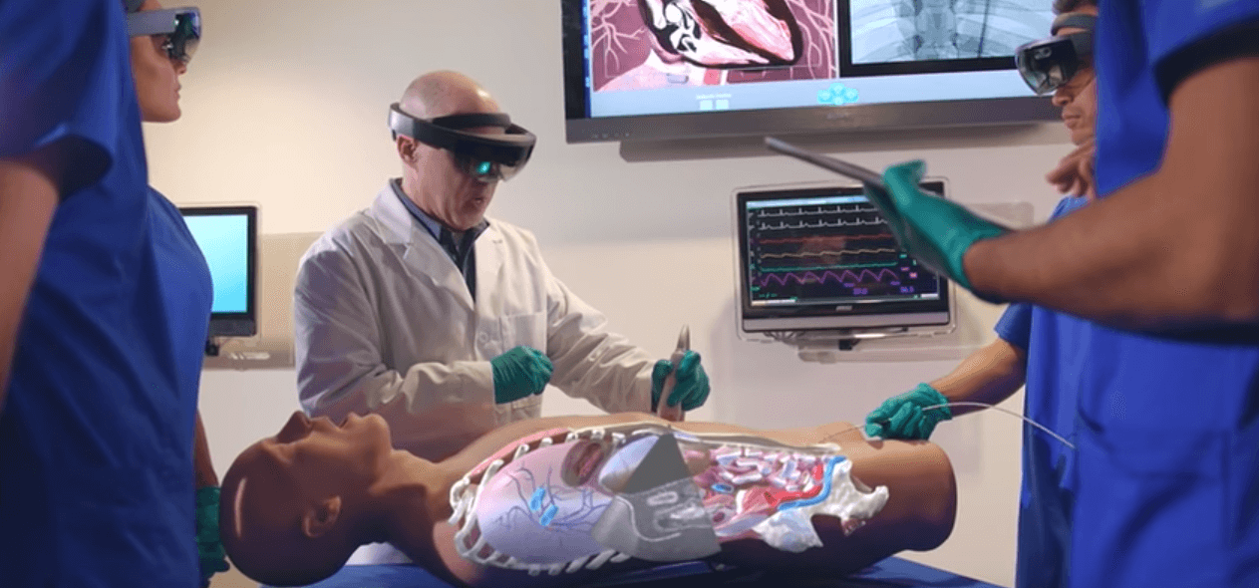
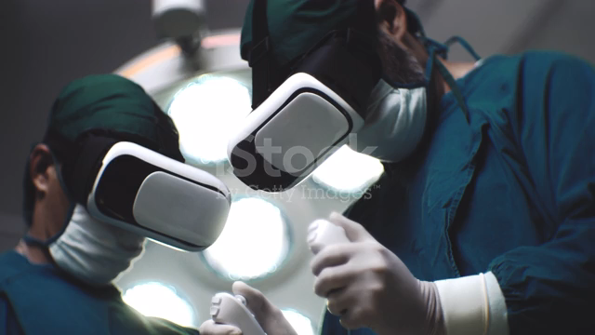
MEDICAL TRAINING

Slide 11
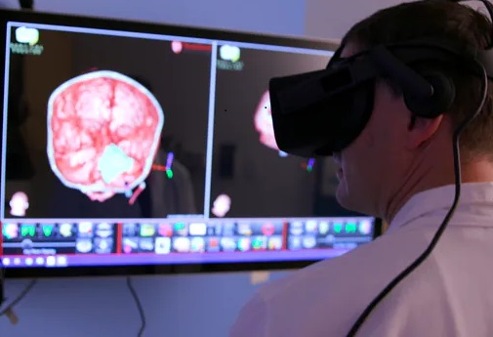
STUDYING CANCER MORE THOROUGHLY
One cubic millimeter of cancer tissue contains around 100,000 cells to study.
Identical model can be rebuilt through VR.

Slide 12






CREATING A VIRTUAL REALITY TUMOR
1
2
3
4
5
Reference picture of tumor is taken
Cutting thin slice of tumor
Analyzing genetic information
Tumor rebuilt in Virtual Reality
Users can now analyze tumor wearing 3-D VR headsets.

Slide 13
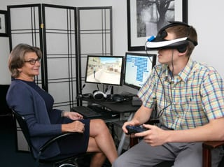
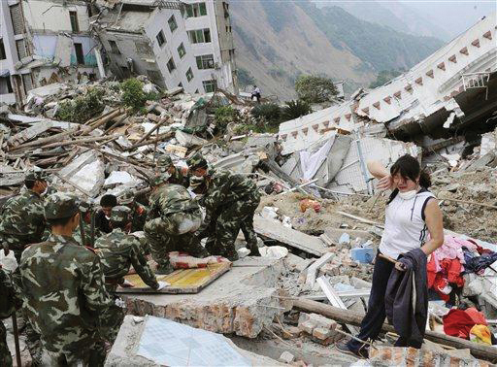
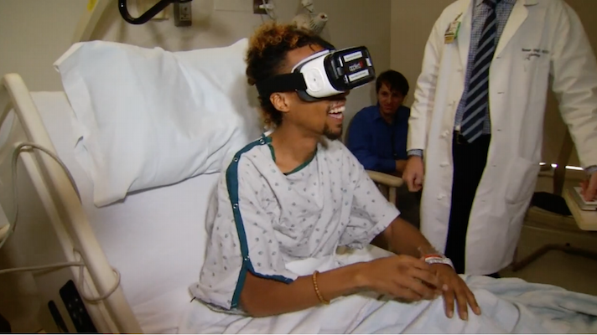
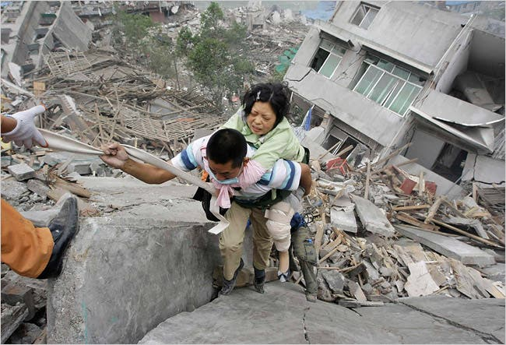
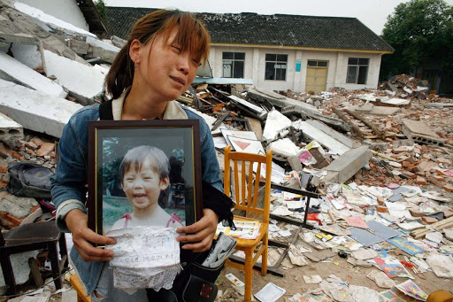
Treating Post Traumatic Stress With Virtual Reality.
Psychological Relief
and Treatment
Used in :
2008 Sichuan Earthquake.
2017 Mexican Earthquake.

Slide 14

MAJOR CHALLENGES
3D design interface
Need of cybersecurity
Lack of regulation
Physical safety risk
Public skepticism

Slide 15

FUTURE OF AR VR

Slide 16
Source : Goldman sachs, Statista Research Department,, jun 2019

Slide 17

CONCLUSION
Continuous evolution and adoption.
Race to capture multi- trillion dollar healthcare industry.
Wide application.
Strategically overcome the challenges.

Slide 18
REFERENCE
https://theappsolutions.com/blog/development/ar-vr-in-healthcare/, accessed on 12/02/2021.
https://www.mobileappdaily.com/impact-of-ar-vr-in-healthcare/, accessed on 12/02/2021.
https://hitconsultant.net/2016/06/30/virtual-reality-patient-experience/, accessed on 16/02/2021.
https://www.biospace.com/article/augmented-and-virtual-reality-in-healthcare-market-future-scope-analysis-to-2025/, accessed on 17/02/2021.
S.Abishake, R.Hariharan, T. Indhumathi, R.Birundha, “Medical analysis using virtual reality”, volume: 07,pp. 2926, 03 March 2020
https://channels.theinnovationenterprise.com/articles/5-major-challenges-of-vr-industry/,accessed on 16/02/2021.

Slide 19

THANK YOU!
For any query reach out to me:
Instagram :
@arya_shahi
Linkedin :
www.linkedin.com/in/arya-shahi-104996192

